Slide 1

Merge Sort algorithm
INFO 6205 Program Structures & Algorithms

Slide 2
Introduction
Merge Sort Algorithm is a widely used and efficient sorting algorithm.
This presentation aims to provide a comprehensive guide to the algorithm, its advantages, and implementation.
By the end, you will have a clear understanding of how to sort data efficiently.

Slide 3
What is Merge Sort?
Merge Sort is a divide-and-conquer algorithm that sorts data by dividing it into smaller chunks, sorting them, and then merging them back together.
The merge sort algorithm is a stable sort, which means that the relative order of equal elements is preserved in the sorted array.
Merge sort is also a recursive algorithm, which means that it can be implemented easily in a variety of programming languages.
The time complexity of merge sort is O(n log n), where n is the number of elements in the array.
The space complexity of merge sort is O(n), where n is the number of elements in the array.

Slide 4
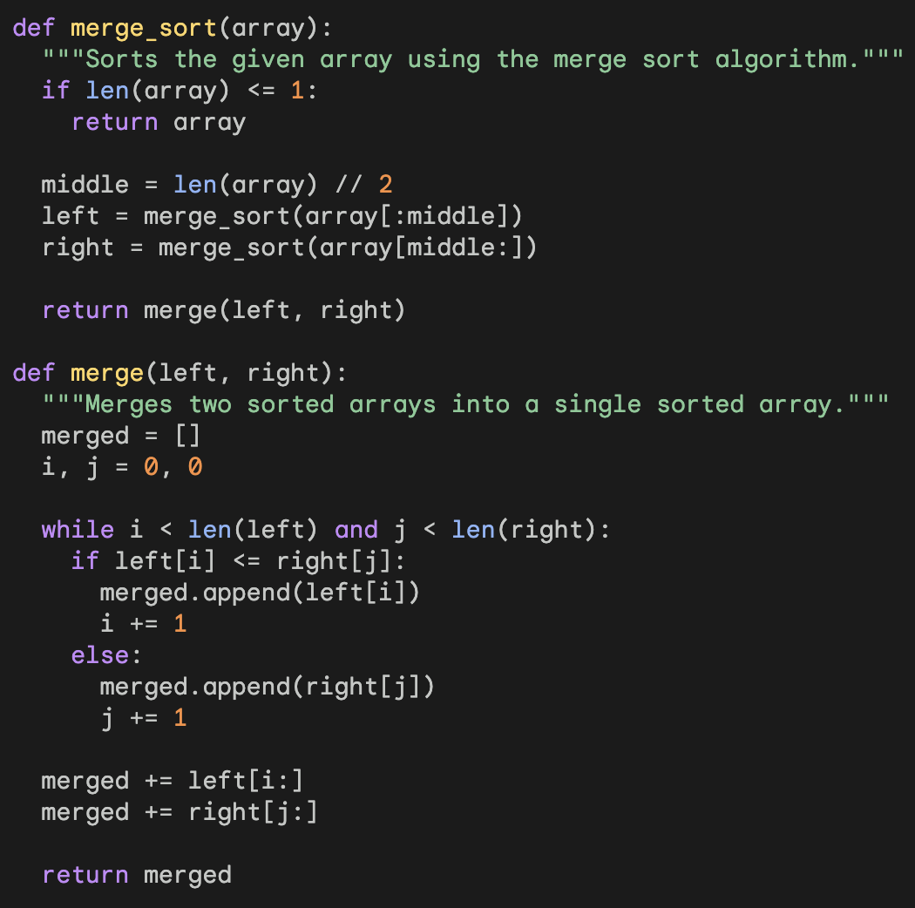
Implementation of merge sort
This implementation uses the divide and conquer approach to sort the array.
The merge_sort() function first checks if the array is of length 1 or less. If it is, then the array is already sorted, and the function returns it.
Otherwise, the function divides the array into two halves and recursively sorts each half.
The two sorted halves are then merged using the merge() function.

Slide 5
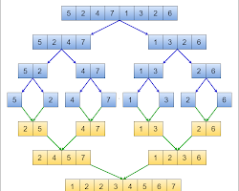
Example
In this Example:
The array is divided into two halves: [5, 2, 4, 7] and [1, 3, 2, 6].
The first half is recursively sorted to get [2, 4, 5, 7].
The second half is recursively sorted to get [1, 2, 3, 6].
The two sorted halves are merged to get [1, 2, 2, 3, 4, 5, 6, 7].

Slide 6
Advantages of Merge Sort
Stable: Merge sort is a stable sort, which means that the relative order of equal elements is preserved in the sorted array. This is important for applications where the order of equal elements is important, such as sorting alphabetically or by social security number.
Efficient: Merge sort has a worst-case time complexity of O(n log n), which makes it one of the most efficient sorting algorithms.
Divide and conquer: Merge sort is a divide-and-conquer algorithm, which makes it easy to understand and implement.
Recursive: Merge sort is a recursive algorithm, which means that it can be easily implemented in a recursive programming language.
Parallelizable: Merge sort can be easily parallelized, which means that it can be used to sort data on multiple processors. This makes merge sort a good choice for sorting large amounts of data in a short amount of time.

Slide 7
Applications of merge sort
Sorting linked lists: Merge sort can be used to sort linked lists without taking up any additional space. This is because the merge step of merge sort can be implemented without making any copies of the elements in the linked lists.
Counting inversions: An inversion is a pair of elements in an array such that the first element is greater than the second element. Merge sort can be used to count the number of inversions in an array. This can be useful for problems such as finding the maximum number of elements that can be moved to the right without creating any inversions.
External sorting: External sorting is a technique for sorting large amounts of data that cannot fit into the main memory of a computer. Merge sort can be used as an external sorting algorithm.
Parallel computing: Merge sort can be easily parallelized, which means that it can be used to sort data on multiple processors. This makes merge sort a good choice for sorting large amounts of data in a short amount of time.

Slide 8
Conclusion
In conclusion, Merge sort is a divide-and-conquer algorithm that sorts an array by recursively dividing it into two halves and then merging the sorted halves back together.
Merge sort is a stable sort, which means that the relative order of equal elements is preserved in the sorted array.
Merge Sort is a highly efficient and widely used sorting algorithm that can be used to sort large amounts of data.
Its stability, predictability, and practical applications make it a valuable tool for data sorting.
Merge sort has a worst-case time complexity of O(n log n), which makes it one of the most efficient sorting algorithms.
Merge sort requires extra space to store the sorted subarrays during the merge step.

Slide 9

Thank you !!!

